Slide 1
2015 Annual General Meeting

Slide 2
Treasurer’s Report

Slide 3
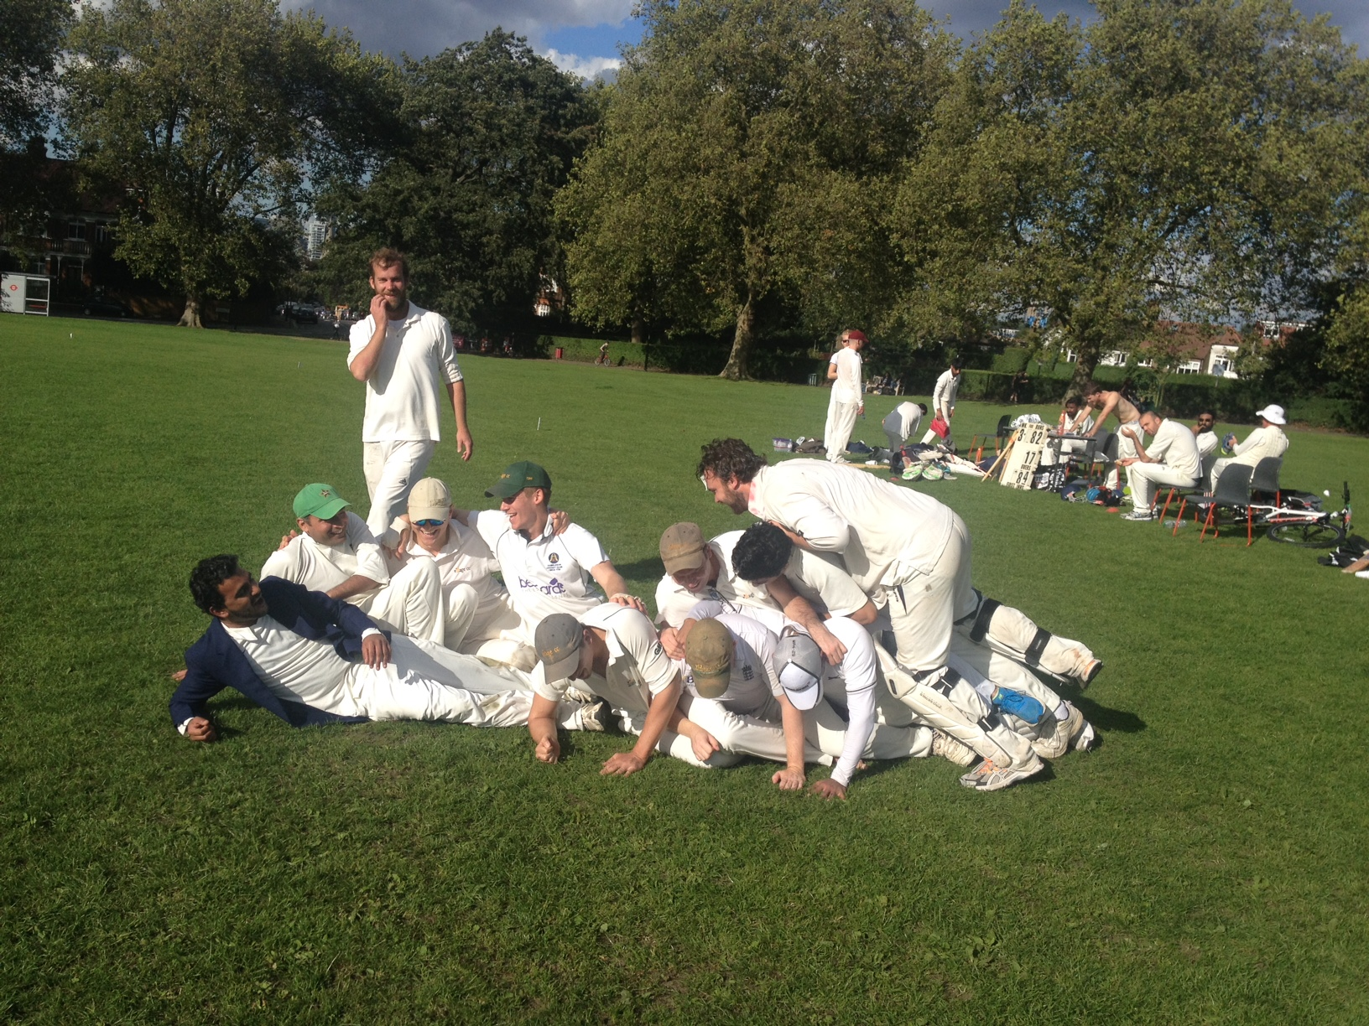
Season in Review
Captain’s Report
The difficult second album
The difficult second album

Slide 4
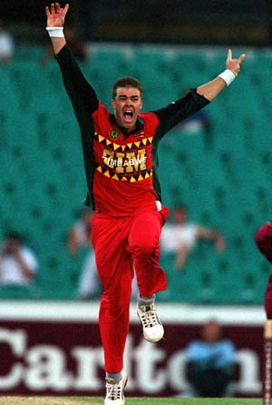
Heath
(2014)

Slide 5
#FacesofCisk
(2015)

Slide 6
#FacesofCisk
Let’s just have a quick one
at the Scotsman…

Slide 7
Review of all time season stats
2004: No records
2005: No records
2006: 4W/9L (31%)
2007: 8W/9L (47%)
2008: 7W/17L (29%)
2009: 15W/8L (65%)
2010: 17W/8L (68%)
2011: 17W/4L (81%)
2012: 15W/7L (68%)
2013: 12W/10L (55%)
2014: 15W/2L (88%)
2015: 11W/11L (50%)

Slide 8
Review of the 2015 season - Stats
Club records set this year
We were oversubscribed for 17 out of 23 matches – a club record, surely
8 players with 10 wickets or more is an equal club record
Ek’s 34 wickets for the season is an equal club record (with KP in 2009)
Only 2 players averaged higher than 30 with the bat – 2nd worst after 2008
Other stats
Team batting average of 21.1 (168 wickets for 3537 runs) vs 24.4 last season
Team bowling average of 20.3 (172 wickets for 3487 runs) vs 16.1 last season
35 players this season, including 6 debutants

Slide 9
Review of the 2015 season - Stats
Bowled out 8 times – not a record but close to (only happened twice in 2014). It meant we gave up 23 overs in total of batting this season.
7 of the 11 losses were by ≤ 3 wickets or < 20 runs
Pretenders x 2, Strongroom, Pink Elephants, Old Whits, SLICC & Beamers
Last season we won 4 of 6 matches by ≤ 3 wickets or < 20 runs.
Village CC WhatsApp in 2015:
TWO RED CARDS Boa & Thomo
FIVE YELLOWS CARDS Pitcher, BOSH, Thomo, WLD & Bilal

Slide 10
2015 milestones
100 games Pitcher & Bomb
3000 runs Harty
2500 runs WLD & Troja
500 runs Cressey & TdM
150 wickets EK
50 wickets Troja & Thomo

Slide 11
New faces for 2015

Slide 12
Fielding in 2014
Last year’s statistics
59 catches
13 WLD
6 TdM
5 Pontin
4 Troja & Pitcher
3 JdM, Harty & Thomo
34 dropped catches
5 Gupte
4 Troja
3 JdM, WLD, Pitcher & Prash
2 TdM, Sam, Boa & Thomo
1 Naz, Louse, Puffett, Tupper & Ball
We took 63% of our chances
(Average of 2 drops per game)

Slide 13
Review of the 2015 season - Fielding
84 catches
WLD
10 Ek & Thomo
8 Troja, TdM & JdM
4 Cressey & Pitcher
3 Bilal
60 dropped catches
11 Pitcher
9 Bilal
7 JdM
4 Ek & Troja
3 TdM, Graham, BOSH, Louse & WLD
We took 58% of our chances
(Average of 2.6 drops per game)

Slide 14
Review of the 2015 season - Bowling
BATTING NO. | BOWLER | WICKETS
1 | THOMPSON | 5
2 | THOMPSON | 6
3 | GUPTE | 7
4 | THOMPSON | 4
5 | BILAL | 5
6 | BILAL | 4
7 | TROJA | 4
8 | BILAL | 3
9 | GUPTE | 4
10 | GUPTE | 4
11 | GUPTE & NAZ | 2

Slide 15
Review of the 2015 season -Bowling
PERCENTAGE OF WICKETS TOP 5 BATSMAN (Min. 10 wickets)
TDM - 82%
THOMPSON - 70%
HAMPTON - 62%
BILAL - 55%
GUPTE - 53%
PERCENTAGE OF WICKETS BOTTOM 4 BATSMAN (Min. 10 wickets)
GUPTE - 32%
TROJA - 23%
TDM - 18%
HAMPTON - 15%
THOMPSON - 13%

Slide 16
All time VCC stats - Bowling
BATTING NO. | BOWLER | WICKETS
1 | KP | 24
2 | KP | 30
3 | GUPTE | 17
4 | LOUSE | 18
5 | GUPTE | 20
6 | GUPTE | 23
7 | GUPTE | 16
8 | GUPTE | 14
9 | GUPTE | 14
10 | GUPTE | 15
11 | GUPTE | 8

Slide 17
All time VCC stats - Bowling
PERCENTAGE OF WICKETS TOP 5 BATSMAN (Min. 30 wickets)
HAMPTON - 76%
BOMB - 75%
RICHARDSON - 73%
BOA - 72%
BECKER - 72%
KP - 70%
THOMPSON - 65%
PERCENTAGE OF WICKETS BOTTOM 4 BATSMAN (Min. 30 wickets)
NAZ - 48%
TROJA - 33%
EK - 31%
PITCHER - 23%
THOMPSON - 22%
LOUSE - 21%
BILAL - 20%

Slide 18
Review of the 2015 season -Bowling
Bowler of the season
 | Overs | Runs conceded | Average | S/R | Best figures | Wickets
E GUPTE | 104 | 520 | 15 | 18.4 | 6/49 | 34
N THOMPSON | 121 | 399 | 13 | 24.2 | 4/8 | 30
B HUSSAIN | 74 | 263 | 11 | 20.2 | 4/31 | 22
B HAMPTON | 46 | 189 | 14 | 21.2 | 3/24 | 13
N TROJA | 50 | 271 | 20 | 23.1 | 3/6 | 13
T DE MELLOW | 71 | 303 | 27 | 38.7 | 3/12 | 11
C PITCHER | 42 | 275 | 25 | 22.9 | 3/0 | 11
N CHOUDHURY | 46 | 243 | 24 | 27.6 | 3/30 | 10

Slide 19
Review of the 2015 season -Batting
Batsman of the season
 | Innings | 100s | 50s | Average | Sixes | Fours | Runs
N TROJA | 16 | 1 | 3 | 48.5 | 13 | 69 | 582
F EXTRAS | 23 | 0 | 0 | 21.9 | 0 | 0 | 503
R CRESSEY | 17 | 0 | 2 | 22 | 6 | 44 | 374
O MORGANS | 17 | 0 | 3 | 27.8 | 3 | 45 | 361
T DE MELLOW | 15 | 0 | 2 | 28.9 | 6 | 43 | 347
J DE MELLOW | 16 | 0 | 2 | 19.6 | 8 | 37 | 314

Slide 20
Captain’s Player of the Season
Match 1 vs Pretenders (Lost by 11 runs)
3. O Morgans (54)
2. S Harty (50)
1. E Gupte (2/14)
Match 2 vs Marsa CC (Won by 3 wickets)
3. C Pitcher (2/17)
2. S Harty (25)
1. N Thompson (1/20)
Match 3 vs Pretenders (Lost by 3 wickets)
3. C Pitcher (3/0)
2. N Thompson (2/10)
1. E Gupte (2/24)
Match 4 vs Southbank CC (Won by 108 runs)
3. J de Mellow (73)
2. B Hussain (3/5)
1. N Thompson (2/6)
Match 5 - BOA CUP (Won by 62 runs)
3. R Cressey (38 & 2/34)
2. J de Mellow (39)
1. G Pontin (34)
Match 6 vs Pecos (Won by 7 wickets)
3. R Cressey (49*)
2. T de Mellow (3/12)
1. C Bosshardt (2/17) DEBUT

Slide 21
Captain’s Player of the Season
Match 7 vs SLICC (Lost by 67 runs)
3. T de Mellow (66)
2. N Choudhury (3/40)
1. B Hussain (3/48)
Match 10 vs Pink Elephants (Lost by 3 wickets)
3. T de Mellow (3/24)
2. E Gupte (2/27 & 25)
1. N Thompson (2/33)
Match 8 vs London Fields (Won by 165 runs)
3. T de Mellow (79 & 1/18)
2. C Bosshardt (44* & 1/17)
1. C Woodhouse (3/22)
Match 11 vs Old Whitgifts (Lost by 1 wicket)
3. B Hampton (58 & 1/19)
2. C Pitcher (3/35)
1. S Harty (34)
Match 9 vs Strongroom (Lost by 3 wickets)
3. S Harty (54)
2. B Hussain (4/31)
1. A Abbas (24*) DEBUT
Match 12 vs DemiJohns (Won by 4 wickets)
3. E Gupte (6/49)
2. G Pontin (63*)
1. N Choudhury (3/30)

Slide 22
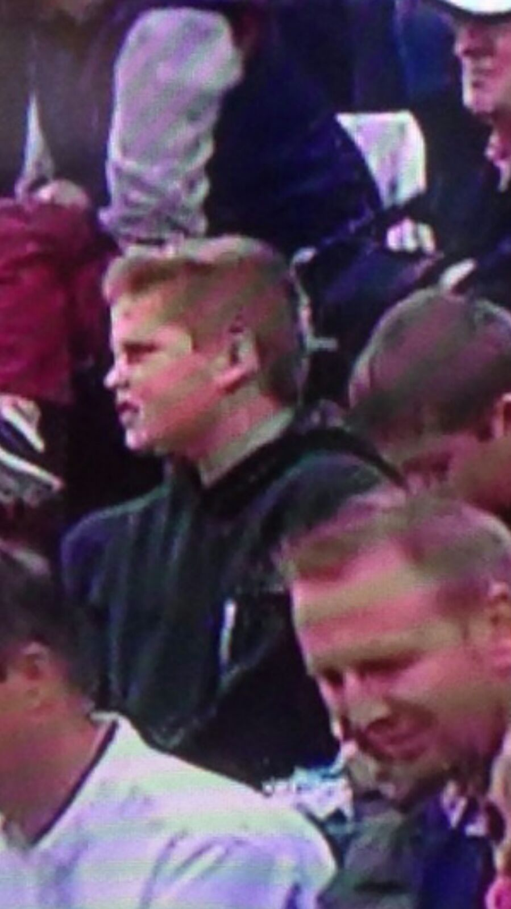
Captain’s Player of the Season
Leaderboard after 12 matches
11 votes TdM
8 votes Pitcher & Harty
7 votes Ek
6 votes Cressey
5 votes JdM, Thomo & Bilal
3 votes WLD, Graham, Ben, Bossy & Naz
1 vote Louse & Abbas

Slide 23
Captain’s Player of the Season
Match 13 vs St Anne’s Allstars (Draw)
3. A White (67)
2. BOSH (44)
1. N Thompson (3/24)
Match 16 vs SLICC (Lost by 19 runs)
3. E Gupte (2/38)
2. N Thompson (2/37)
1. T de Mellow (0/24 & 18)
Match 14 vs HAC (Lost by 45 runs)
3. B Hampton (36 & 2/20)
2. C Pitcher (25)
1. B Hussain (2/25)
Match 17 vs Bengal Troopers (Won by 27 runs)
3. C Bosshardt (3/12)
2. R Cressey (56)
1. B Hampton (2/15)
Match 15 vs Raynes Park (Lost by 7 wickets)
3. E Gupte (55*)
2. N Thompson (40)
1. R Cressey (1/4)
Match 18 vs Strongroom CC (Won by 6 wickets)
3. J de Mellow (59)
2. B Hampton (3/24)
1. R Cressey (53)

Slide 24
Captain’s Player of the Season
Match 19 vs HAC (Won by 4 wickets)
3. O Morgans (68)
2. T de Mellow (48)
1. C Bosshardt (21* & 0/43)
Match 22 vs Hobgoblin Nomads (Won by 7 wickets)
3. T de Mellow (25* & a blinder)
2. N Thompson (2/11)
1. B Hussain (3/7)
Match 20 vs COBCC (Lost by 5 wickets)
3. R Cressey (30)
2. B Hussain (1/12)
1. G Tupper (28)
Match 23 vs Beamers (Lost by 3 wickets)
3. N Thompson (41 & 2/12)
2. B Hussain (666 / 30 & 2/27)
1. O Morgans (23)
Match 21 vs St Clements CC (Won by 6 wickets)
3. O Morgans (55*)
2. N Thompson (4/8)
1. T de Mellow (32*)

Slide 25
Captain’s Player of the Season
And the winner is…
Final count
18 votes - TdM
17 votes - Thomo
13 votes - Cressey & Ek
11 votes - Bilal
10 votes - WLD & Pitcher
9 votes - Ben
8 votes - JdM & Harty
7 votes - Bossy
3 votes - Naz, Bomb & Graham
2 votes - BOSH
1 vote - Louse, Giles & Abrar

Slide 26
Most Improved Saul Reid Award

Slide 27
Best newcomer

Slide 28
WAG of the year

Slide 29
WAG’s player of the year

Slide 30
Moment of the season
Nominations included:
Pitcher’s triple wicket maiden three-fer in Malta
TdM’s meltdown
Morgs hitting a six into the pavilion
Naz’s no-ball gate
Troja’s ton
EK’s 6-fer in front of the folks
Beating Hobgoblins
Winning at Demijohns for the second year in a row
TDM catching a six and falling in a bin while waiting to bat
But the winner is…
BEATING HAC AT HAC

Slide 31
Best contribution on social media
Nominations included:
Ollie Ball for random but hilarious contributions
Pitcher’s real-time Twitter updates and general twitter contributions
General WhatsApp fun and games
#FacesofCisk
But the winner is…
BOA’S WORLD CUP MELTDOWN

Slide 32
Players’ Player of the Year

Slide 33
Corridor of Uncertainty
Graham Pontin
WLD
Parp!
KP
Bomb
John Lucarotti
Andy Richardson
Matt Boa
AA Page

Slide 34
Finally a big thank you to this year’s Committee

Slide 35
2016 Committee Let the voting commence

